Slide 1
Memory and Programmable Logic

Slide 2
7-1. Introduction
There are two types of memories that are used in digital systems:
Random-access memory(RAM): perform both the write and read operations.
Read-only memory(ROM): perform only the read operation.
The read-only memory is a programmable logic device. Other such units are the programmable logic array(PLA), the programmable array logic(PAL), and the field-programmable gate array(FPGA).

Slide 3
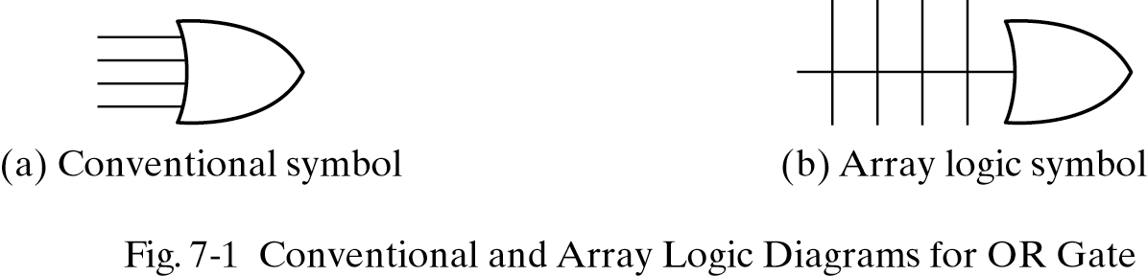
Array logic
A typical programmable logic device may have hundreds to millions of gates interconnected through hundreds to thousands of internal paths.
In order to show the internal logic diagram in a concise form, it is necessary to employ a special gate symbology applicable to array logic.

Slide 4
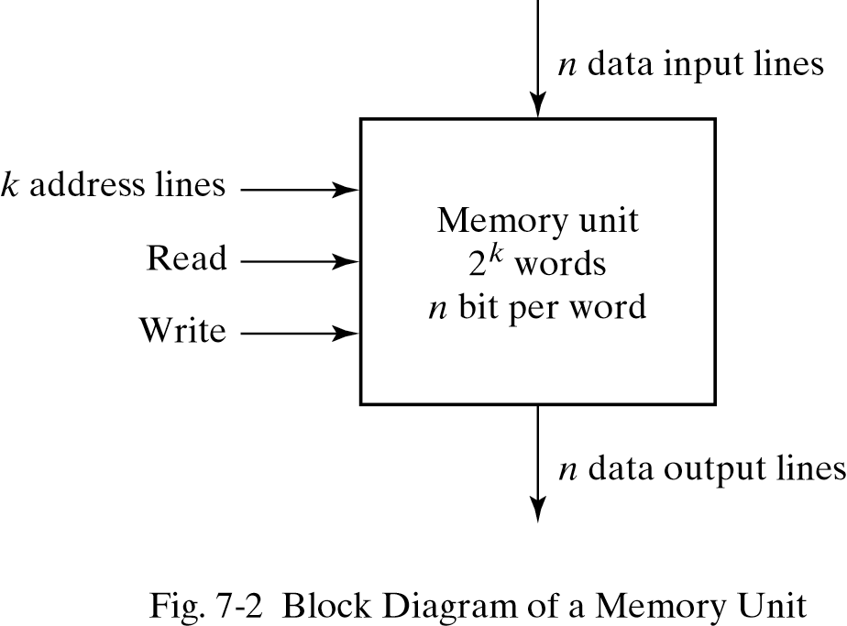
7-2. Random-Access Memory
A memory unit stores binary information in groups of bits called words.
1 byte = 8 bits
1 word = 2 bytes
The communication between a memory and its environment is achieved through data input and output lines, address selection lines, and control lines that specify the direction of transfer.

Slide 5
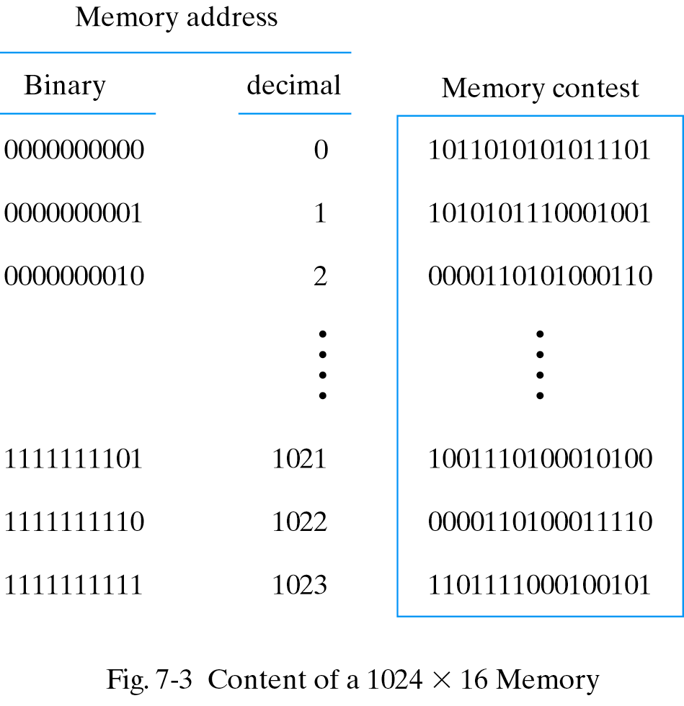
Content of a memory
Each word in memory is assigned an identification number, called an address, starting from 0 up to 2^{k}-1, where k is the number of address lines.
The number of words in a memory with one of the letters K=2¹⁰, M=2²⁰, or G=2³⁰.
64K = 2¹⁶ 2M = 2²¹
4G = 2³²

Slide 6
Write and Read operations
Transferring a new word to be stored into memory:
Apply the binary address of the desired word to the address lines.
Apply the data bits that must be stored in memory to the data input lines.
Activate the write input.

Slide 7
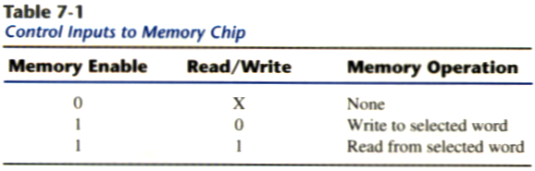
Write and Read operations
Transferring a stored word out of memory:
Apply the binary address of the desired word to the address lines.
Activate the read input.
Commercial memory sometimes provide the two control inputs for reading and writing in a somewhat different configuration in table 7-1.

Slide 8
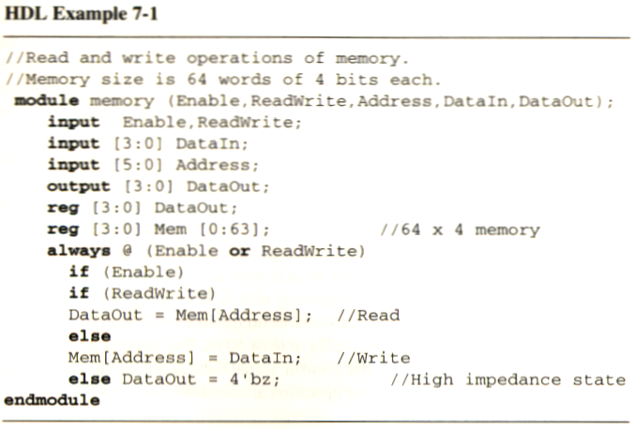
Memory description in HDL
A memory of 1024 words with 16-bits per word is declared as
reg [15:0] memword[0:1023];
Read/Write = 1
DataOut ← Mem[Address];
Read/Write =0
Mem[Address] ← DataIn;

Slide 9
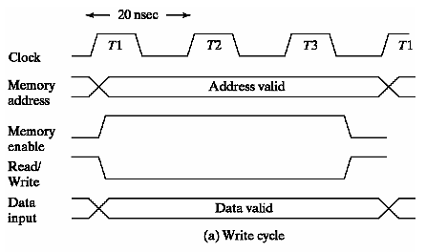
Timing Waveforms (write)
The access time and cycle time of the memory must be within a time equal to a fixed number of CPU clock cycles.
The memory enable and the read/write signals must be activated after the signals in the address lines are stable to avoid destroying data in other memory words.
Enable and read/write signals must stay active for at least 50ns.

Slide 10
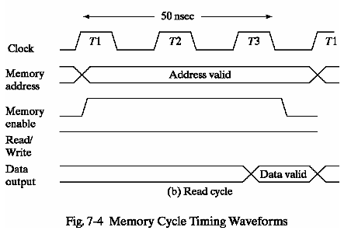
Timing Waveforms (read)
The CPU can transfer the data into one of its internal registers during the negative transition of T3.

Slide 11
Types of memories
In random-access memory, the word locations may be thought of as being separated in space, with each word occupying one particular location.
In sequential-access memory, the information stored in some medium is not immediately accessible, but is available only certain intervals of time. A magnetic disk or tape unit is of this type.

Slide 12
Types of memories
In a random-access memory, the access time is always the same regardless of the particular location of the word.
In a sequential-access memory, the time it takes to access a word depends on the position of the word with respect to the reading head position; therefore, the access time is variable.

Slide 13
Static RAM
SRAM consists essentially of internal latches that store the binary information.
The stored information remains valid as long as power is applied to the unit.
SRAM is easier to use and has shorter read and write cycles.
Low density, low capacity, high cost, high speed, high power consumption.

Slide 14
Dynamic RAM
DRAM stores the binary information in the form of electric charges on capacitors.
The capacitors are provided inside the chip by MOS transistors.
The capacitors tends to discharge with time and must be periodically recharged by refreshing the dynamic memory.

Slide 15
Dynamic RAM
DRAM offers reduced power consumption and larger storage capacity in a single memory chip.
High density, high capacity, low cost, low speed, low power consumption.

Slide 16
Types of memories
Memory units that lose stored information when power is turned off are said to be volatile.
Both static and dynamic, are of this category since the binary cells need external power to maintain the stored information.
Nonvolatile memory, such as magnetic disk, ROM, retains its stored information after removal of power.

Slide 17
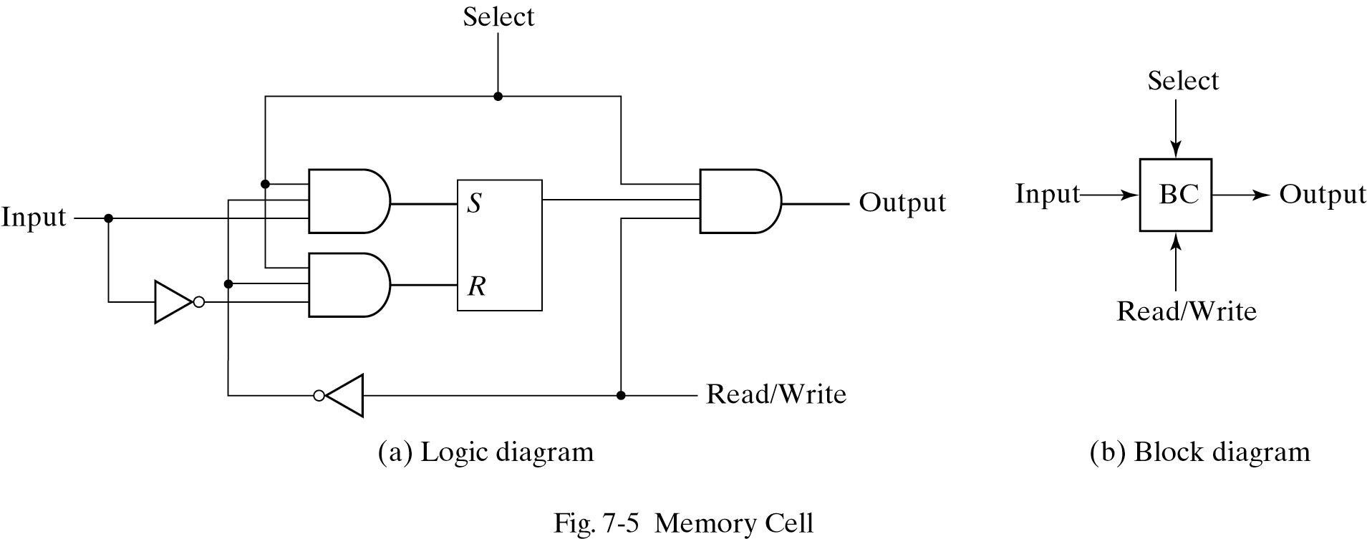
7-3. Memory decoding
The equivalent logic of a binary cell that stores one bit of information is shown below.
Read/Write = 0, select = 1, input data to S-R latch
Read/Write = 1, select = 1, output data from S-R latch
SR latch with NOR gates
Ref. Figure 5-3

Slide 18
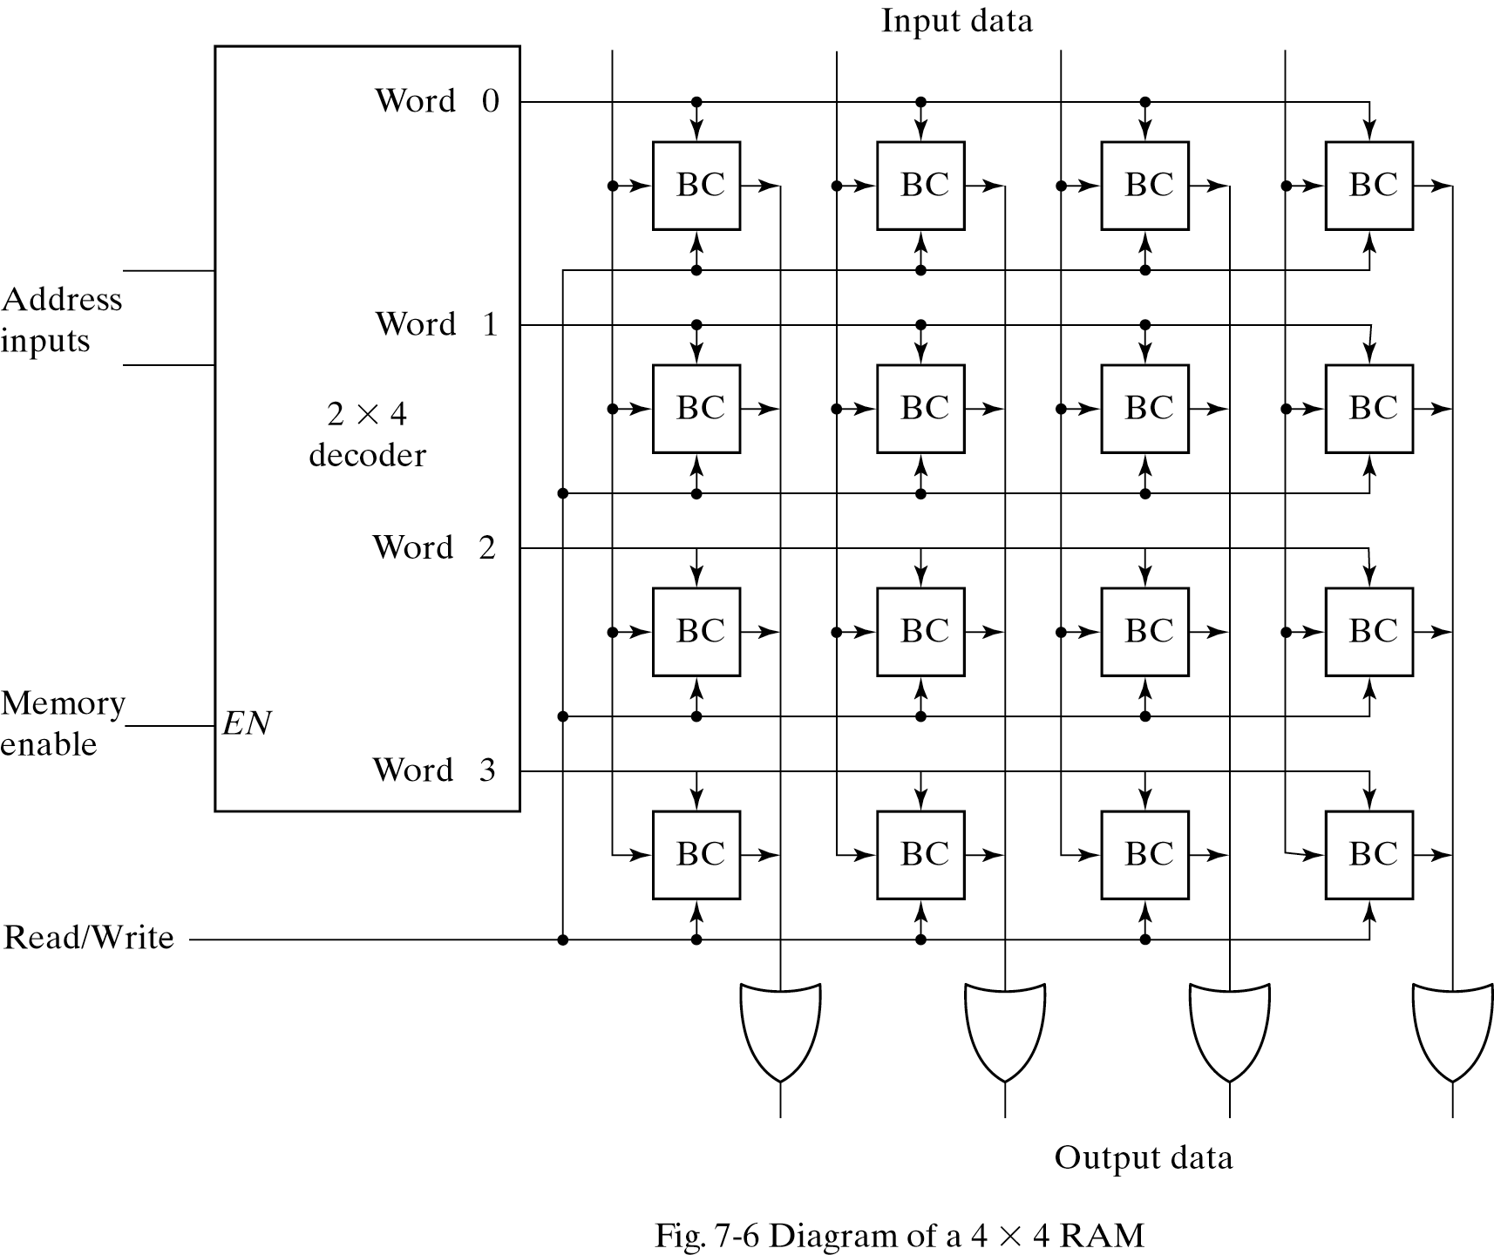
4X4 RAM
There is a need for decoding circuits to select the memory word specified by the input address.
During the read operation, the four bits of the selected word go through OR gates to the output terminals.
During the write operation, the data available in the input lines are transferred into the four binary cells of the selected word.
A memory with 2^{k} words of n bits per word requires k address lines that go into
kx2^{k} decoder.

Slide 19
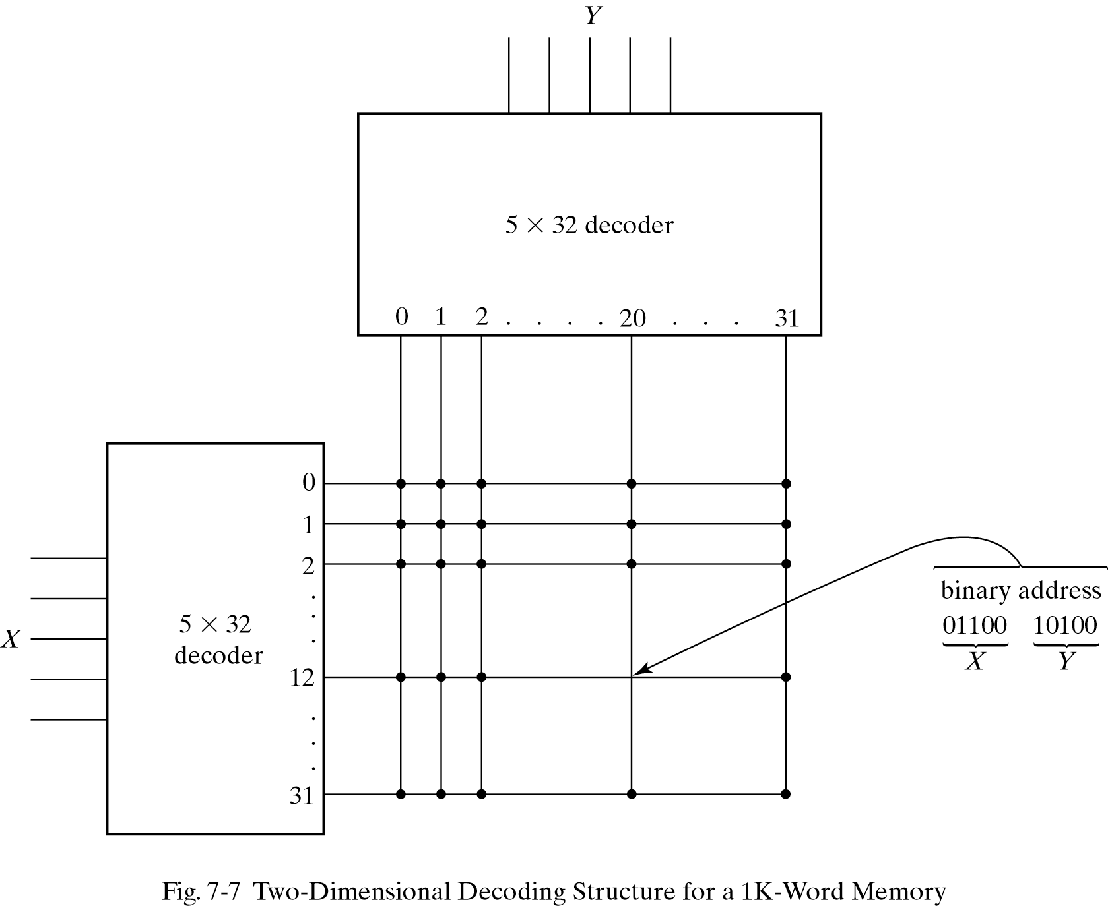
Coincident decoding
address
A decoder with k inputs and 2^{k} outputs requires 2^{k} AND gates with k inputs per gate.
Two decoding in a two-dimensional selection scheme can reduce the number of inputs per gate.
1K-word memory, instead of using a single 10X1024 decoder, we use two 5X32 decoders.

Slide 20
Address multiplexing
DRAMs typically have four times the density of SRAM.
The cost per bit of DRAM storage is three to four times less than SRAM. Another factor is lower power requirement.

Slide 21
Address multiplexing
Address multiplexing will reduce the number of pins in the IC package.
In a two-dimensional array, the address is applied in two parts at different times, with the row address first and the column address second. Since the same set of pins is used for both parts of the address, so can decrease the size of package significantly.

Slide 22
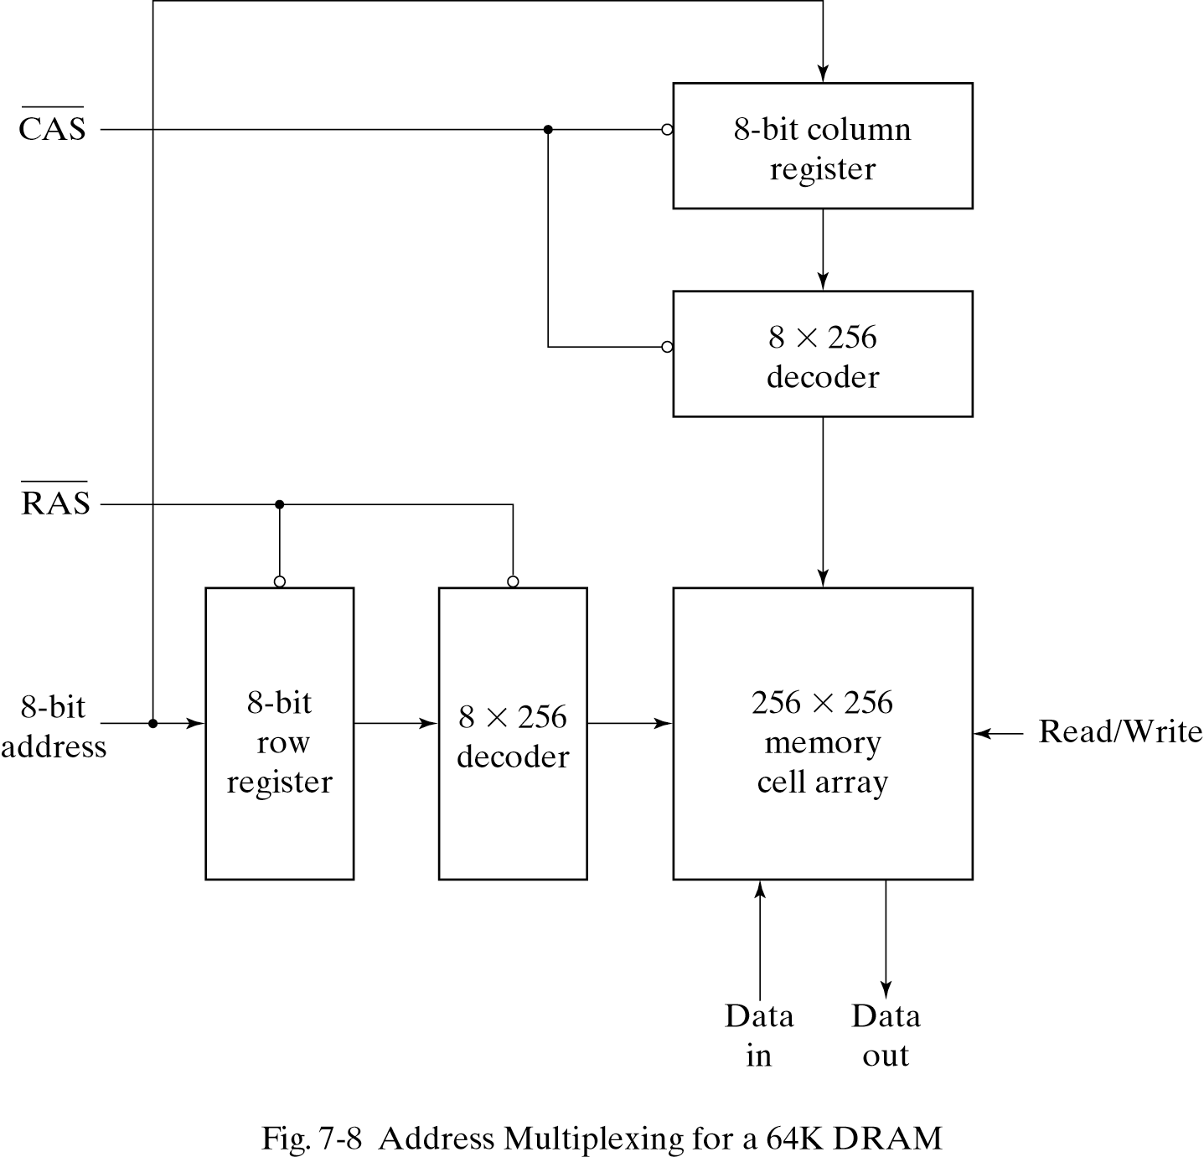
Address multiplexing for 64K DRAM
After a time equivalent to the settling time of the row selection, RAS goes back to the 1 level.
Registers are used to store the addresses of the row and column.
CAS must go back to the 1 level before initialing another memory operation.
Column Address Selection
Row Address Selection

Slide 23
7-4. Error detection and correction
It is protecting the occasional errors in storing and retrieving the binary information.
Parity can be checked the error, but it can’t be corrected.
An error-correcting code generates multiple parity check bits that are stored with the data word in memory.

Slide 24
Hamming Code
One of the most common used in RAM was devised by R. W. Hamming (called Hamming code).
In Hamming code:
k = parity bits in n-bit data word,
forming a new word of n + k bits. Those positions numbered as a power of 2 are reserved for the parity bits.
the remaining bits are the data bits.

Slide 25
Hamming Code
Ex. Consider the 8-bit data word 11000100. we include four parity bits with it and arrange the 12 bits as follows:
Bit position: 1 2 3 4 5 6 7 8 9 10 11 12
P₁ P₂ 1 P₄ 1 0 0 P₈ 0 1 0 0
P₁ = XOR of bits(3,5,7,9,11) = 1 ⊕ 1 ⊕ 0 ⊕ 0 ⊕ 0 = 0
P₂ = XOR of bits(3,6,7,10,11) = 1 ⊕ 0 ⊕ 0 ⊕ 1 ⊕ 0 = 0
P₄ = XOR of bits(5,6,7,12) = 1 ⊕ 0 ⊕ 0 ⊕ 0 = 1
P₈ = XOR of bits(9,10,11,12) = 0 ⊕ 1 ⊕ 0 ⊕ 0 = 1

Slide 26
Hamming Code
The data is stored in memory together with the parity bit as 12-bit composite word.
Bit position: 1 2 3 4 5 6 7 8 9 10 11 12
0 0 1 1 1 0 0 1 0 1 0 0
When read from memory, the parity is checked over the same combination of bits including the parity bit.
C₁ = XOR of bits(3,5,7,9,11)
C₂ = XOR of bits(3,6,7,10,11)
C₄ = XOR of bits(5,6,7,12)
C₈ = XOR of bits(9,10,11,12)

Slide 27
Error-Detection
A 0 check bit designates an even parity over the checked bits and a 1 designates an odd parity.
Since the bits were stored with even parity, the result,
C = C₈C₄C₂C₁ = 0000, indicates that no error has occurred.
If C ≠ 0, then the 4-bit binary number formed by the check bits gives the position of the erroneous bit.

Slide 28
Example
Bit position: 1 2 3 4 5 6 7 8 9 10 11 12
0 0 1 1 1 0 0 1 0 1 0 0 No error
1 0 1 1 1 0 0 1 0 1 0 0 Error in bit 1
0 0 1 1 0 0 0 1 0 1 0 0 Error in bit 5
Evaluating the XOR of the corresponding bits, get the four check bits
C₈ C₄ C₂ C₁
_{For no error: 0 0 0 0}
with error in bit 1: 0 0 0 1
with error in bit 5: 0 1 0 1

Slide 29
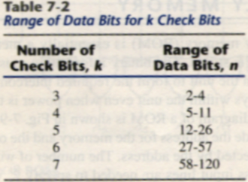
Hamming Code
The Hamming Code can be used for data words of any length.
Total bit in Hamming Code is n + k bits, the syndrome value C consists of k bits and has a range of 2^{k} value between 0 and 2^{k} − 1. the range of k must be equal to or greater than n + k, giving the relationship
2^{k}-1 ≥ n + k

Slide 30
Single-Error correction, Double-Error detection
The Hamming Code can detect and correct only a single error.
By adding another parity bit to the coded word, the Hamming Code can be used to correct a single error and detect double errors. Becomes 001110010100P₁₃.
001110010100 P₁₃ → 001110010100 1
P= XOR( 001110010100 1 )
if P = 0, the parity is correct (even parity), but if P = 1, then the parity over the 13 bits is incorrect (odd parity).
the following four cases can occur:

Slide 31
Single-Error correction, Double-Error detection
If C = 0 and P = 0, no error occurred
If C ≠ 0 and P = 1, a single error occurred that can be corrected
If C ≠ 0 and P = 0, a double error occurred that is detected but that cannot be corrected
If C = 0 and P = 1, an error occurred in the P₁₃ bit

Slide 32
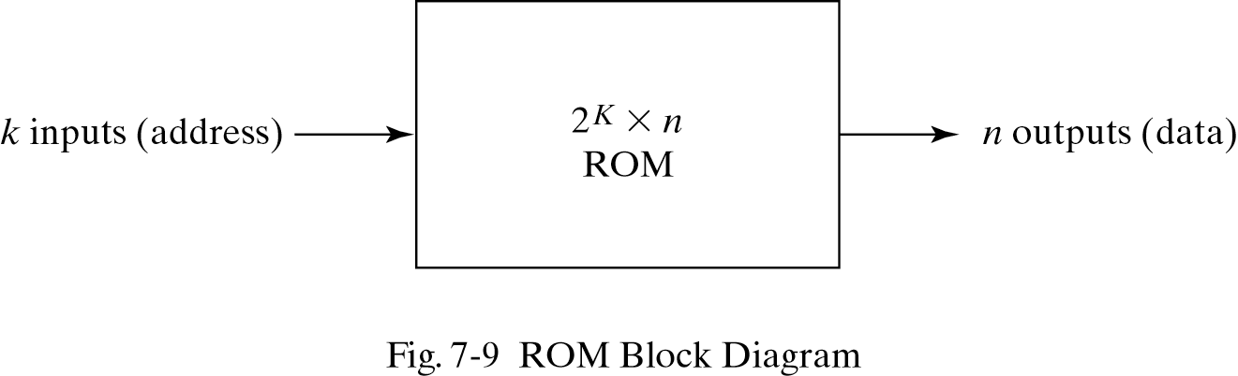
7-5. Read-Only Memory
A block diagram of a ROM is shown below. It consists of k address inputs and n data outputs.
The number of words in a ROM is determined from the fact that k address input lines are needed to specify 2^{k} words.

Slide 33
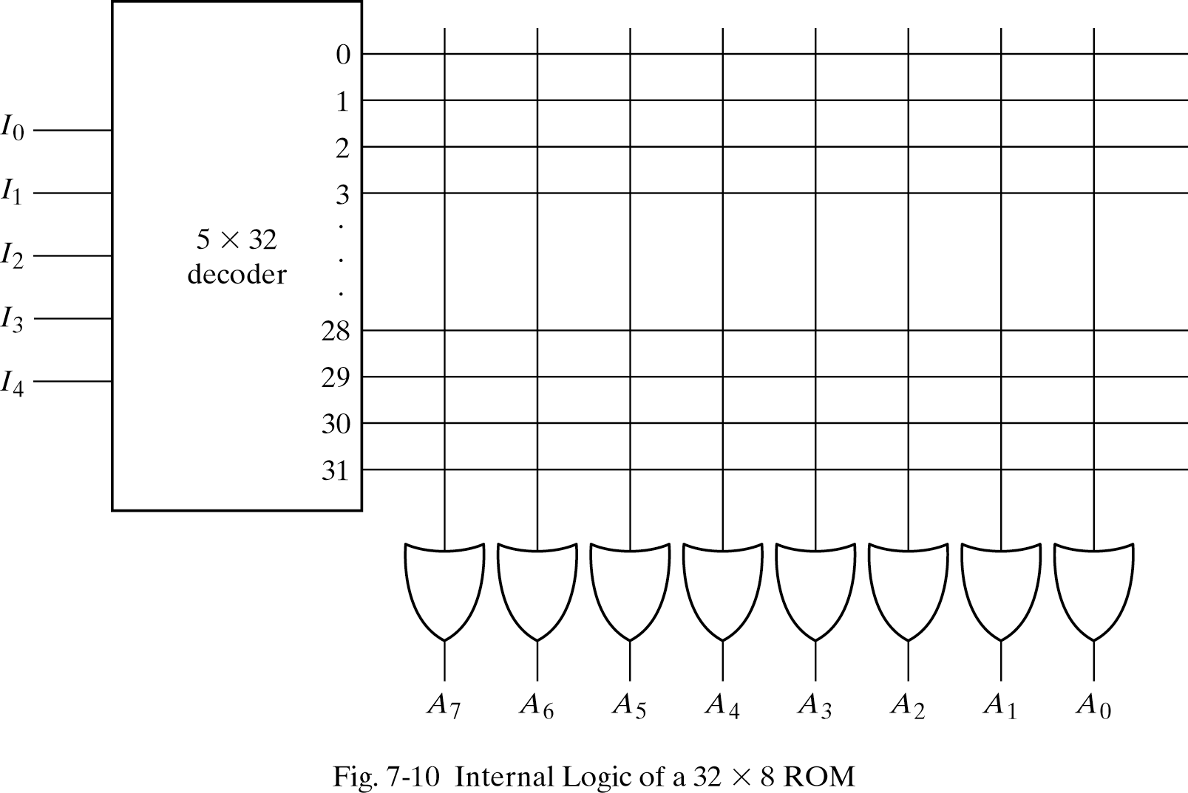
Construction of ROM
Each output of the decoder represents a memory address.
Each OR gate must be considered as having 32 inputs.
A 2^{k} X n ROM will have an internal k X 2^{k} decoder and n OR gates.

Slide 34
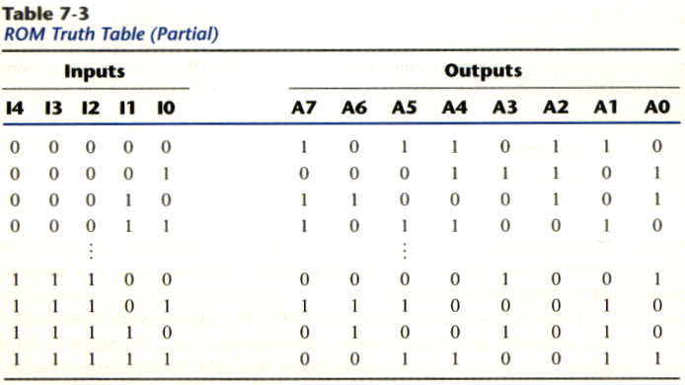
Truth table of ROM
A programmable connection between to lines is logically equivalent to a switch that can be altered to either be close or open.
Intersection between two lines is sometimes called a cross-point.

Slide 35
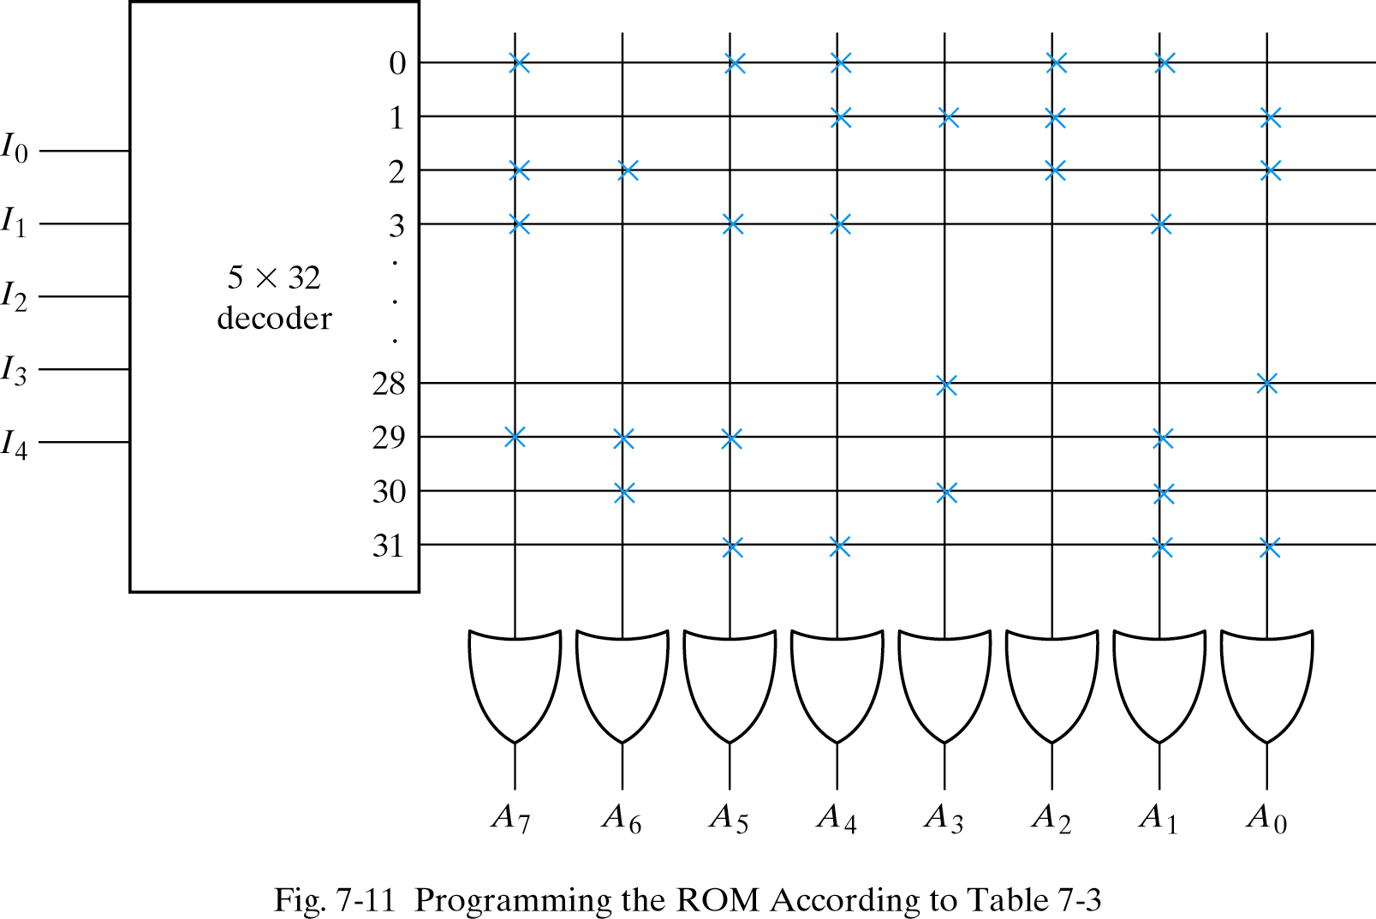
Programming the ROM
In Table 7-3, 0 → no connection
1 → connection
Address 3 = 10110010 is permanent storage using fuse link
1 0 1 1 0 0 1 0
X : means connection

Slide 36
Combinational circuit implementation
The internal operation of a ROM can be interpreted in two way: First, a memory unit that contains a fixed pattern of stored words. Second, implements a combinational circuit.
Fig. 7-11 may be considered as a combinational circuit with eight outputs, each being a function of the five input variables.
A₇(I₄, I₃, I₂, I₁, I₀) = Σ(0,2,3…,29)
Sum of minterms
In Table 7-3, output A₇

Slide 37
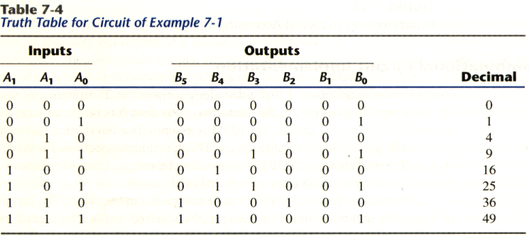
Example
Design a combinational circuit using a ROM. The circuit accepts a 3-bit number and generates an output binary number equal to the square of the input number.
Derive truth table first

Slide 38
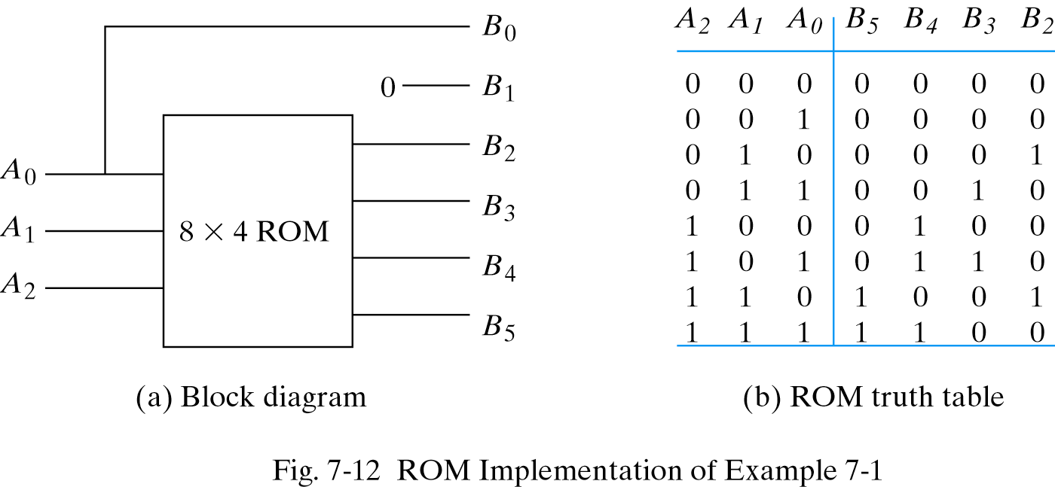
Example

Slide 39
Types of ROMs
The required paths in a ROM may be programmed in four different ways.
Mask programming: fabrication process
Read-only memory or PROM: blown fuse /fuse intact
Erasable PROM or EPROM: placed under a special ultraviolet light for a given period of time will erase the pattern in ROM.
Electrically-erasable PROM(EEPROM): erased with an electrical signal instead of ultraviolet light.

Slide 40
Combinational PLDs
A combinational PLD is an integrated circuit with programmable gates divided into an AND array and an OR array to provide an AND-OR sum of product implementation.
PROM: fixed AND array constructed as a decoder and programmable OR array.
PAL: programmable AND array and fixed OR array.
PLA: both the AND and OR arrays can be programmed.

Slide 41
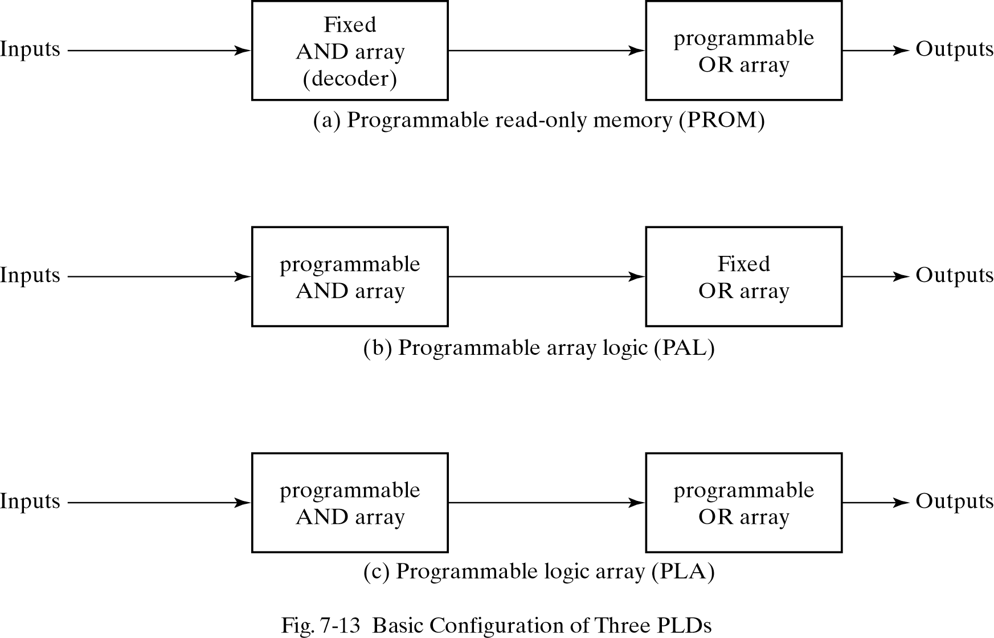
Combinational PLDs

Slide 42
7-6. Programmable Logic Array
Fig.7-14, the decoder in PROM is replaced by an array of AND gates that can be programmed to generate any product term of the input variables.
The product terms are then connected to OR gates to provide the sum of products for the required Boolean functions.
The output is inverted when the XOR input is connected to 1 (since x⊕1 = x’). The output doesn’t change and connect to 0 (since x⊕0 = x).

Slide 43
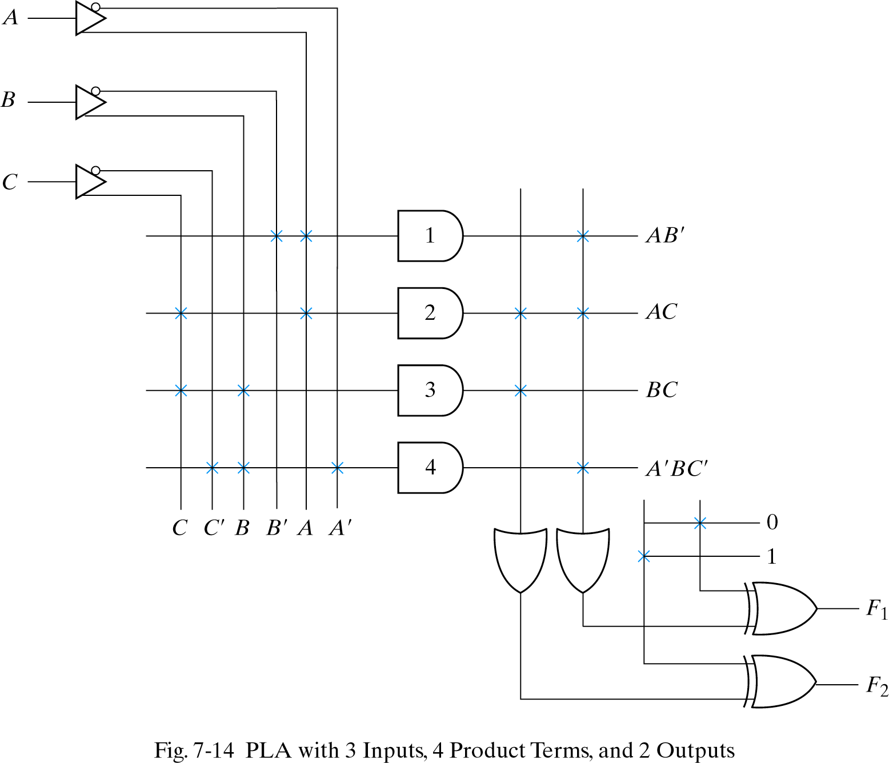
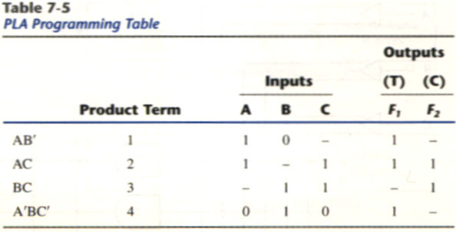
PLA
F1 = AB’+AC+A’BC’
F2 = (AC+BC)’

Slide 44
Programming Table
First: lists the product terms numerically
Second: specifies the required paths between inputs and AND gates
Third: specifies the paths between the AND and OR gates
For each output variable, we may have a T(true) or C(complement) for programming the XOR gate

Slide 45
Simplification of PLA
Careful investigation must be undertaken in order to reduce the number of distinct product terms, PLA has a finite number of AND gates.
Both the true and complement of each function should be simplified to see which one can be expressed with fewer product terms and which one provides product terms that are common to other functions.

Slide 46
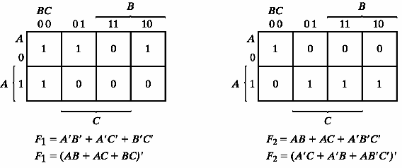
Example 7-2
Implement the following two Boolean functions with a PLA:
F₁(A, B, C) = ∑(0, 1, 2, 4)
F₂(A, B, C) = ∑(0, 5, 6, 7)
The two functions are simplified in the maps of Fig.7-15
1 elements
0 elements

Slide 47
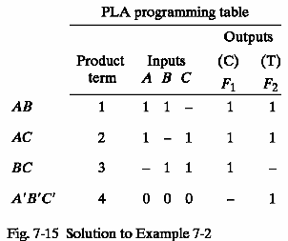
PLA table by simplifying the function
Both the true and complement of the functions are simplified in sum of products.
We can find the same terms from the group terms of the functions of F₁, F₁’,F₂ and F₂’ which will make the minimum terms.
F1 = (AB + AC + BC)’
F2 = AB + AC + A’B’C’

Slide 48
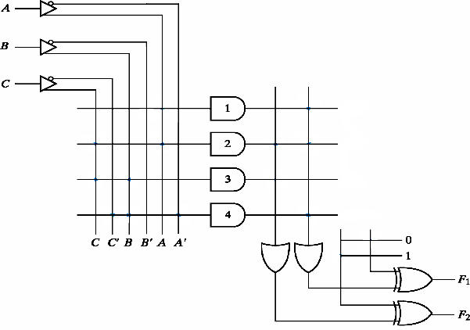
PLA implementation
AB
AC
BC
A’B’C’

Slide 49
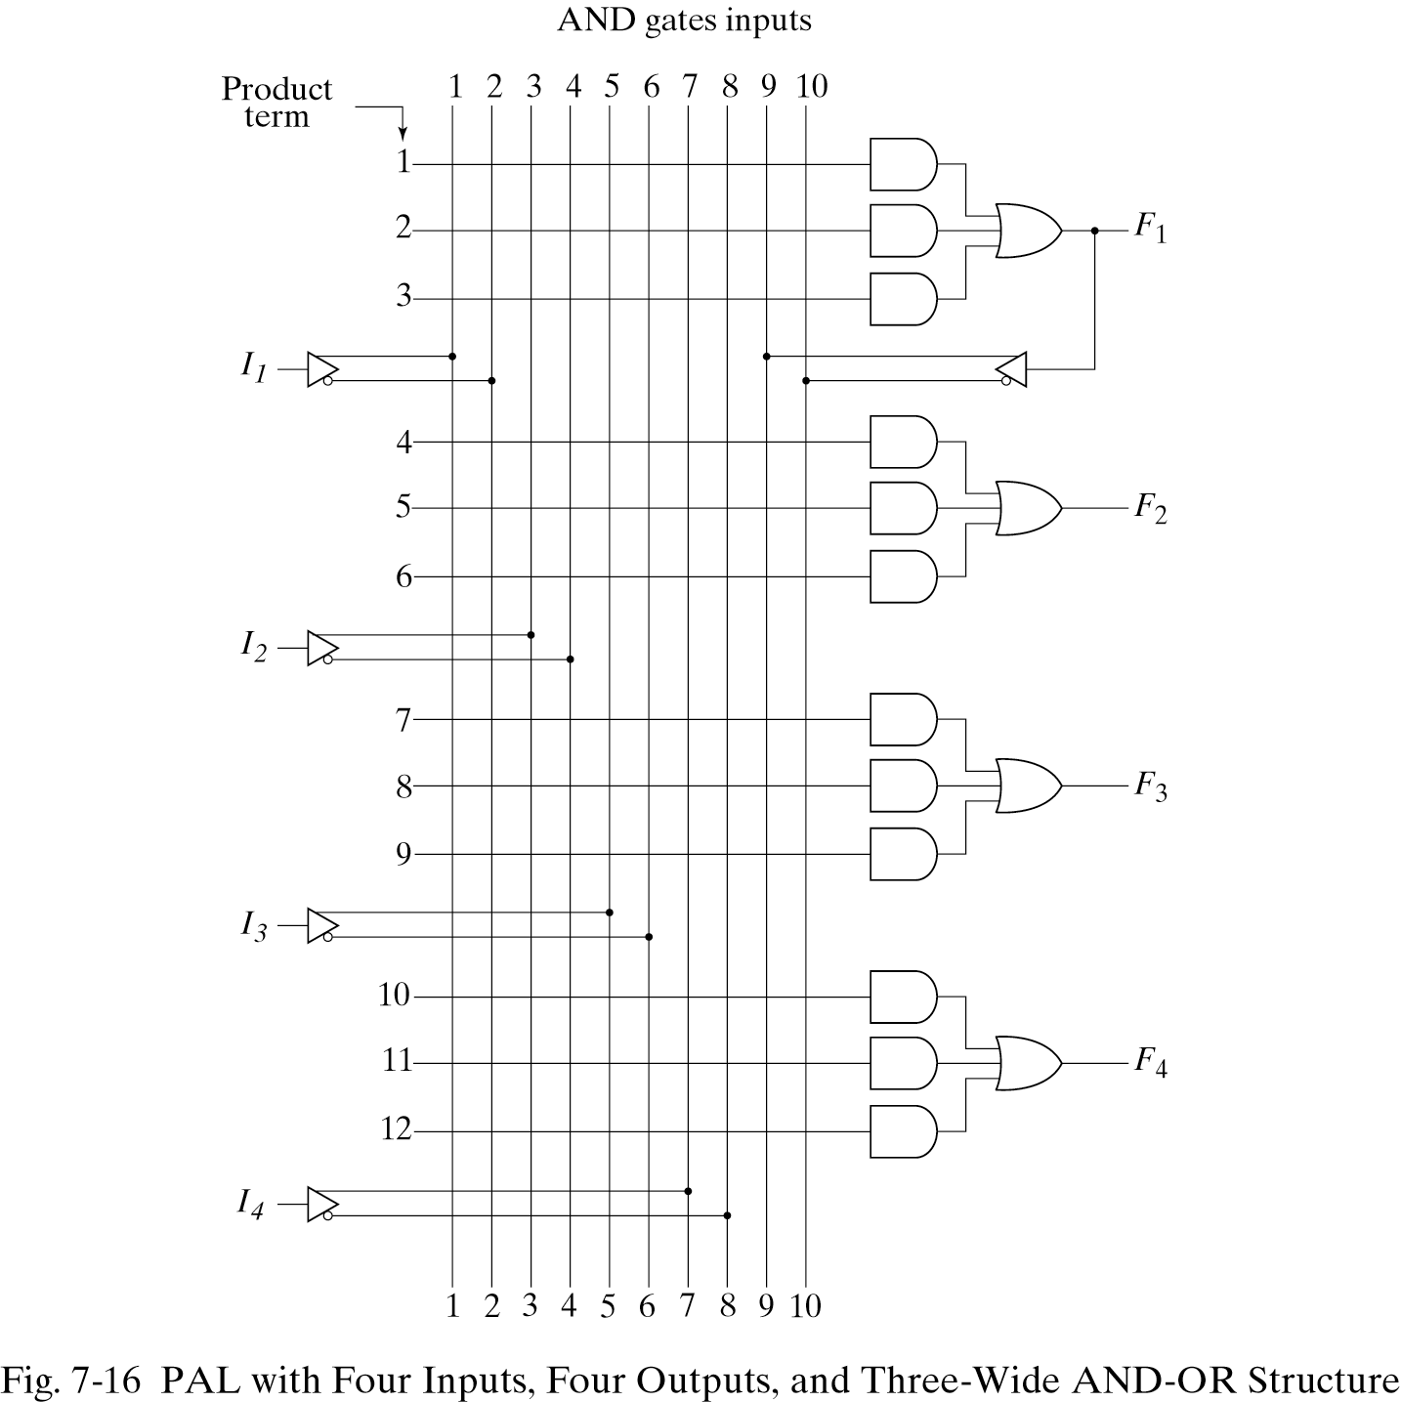
7-7. Programmable Array Logic
The PAL is a programmable logic device with a fixed OR array and a programmable AND array.

Slide 50
PAL
When designing with a PAL, the Boolean functions must be simplified to fit into each section.
Unlike the PLA, a product term cannot be shared among two or more OR gates. Therefore, each function can be simplified by itself without regard to common product terms.
The output terminals are sometimes driven by three-state buffers or inverters.

Slide 51
Example
w(A, B, C, D) = ∑(2, 12, 13)
x(A, B, C, D) = ∑(7, 8, 9, 10, 11, 12, 13, 14, 15)
y(A, B, C, D) = ∑(0, 2, 3, 4, 5, 6, 7, 8, 10, 11, 15)
z(A, B, C, D) = ∑(1, 2, 8, 12, 13)
Simplifying the four functions as following Boolean functions:
w = ABC’ + A’B’CD’
x = A + BCD
y = A’B + CD + B’D’
z = ABC’ + A’B’CD’ + AC’D’ + A’B’C’D = w + AC’D’ + A’B’C’D

Slide 52
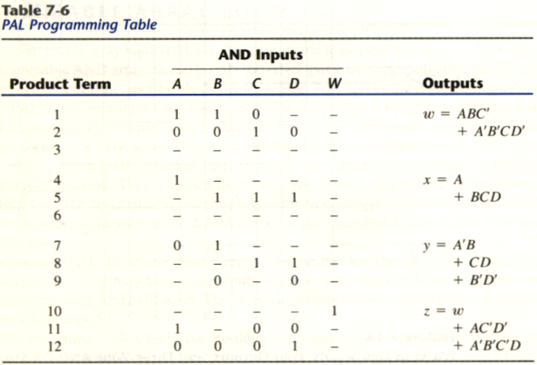
PAL Table
z has four product terms, and we can replace by w with two product terms, this will reduce the number of terms for z from four to three.

Slide 53
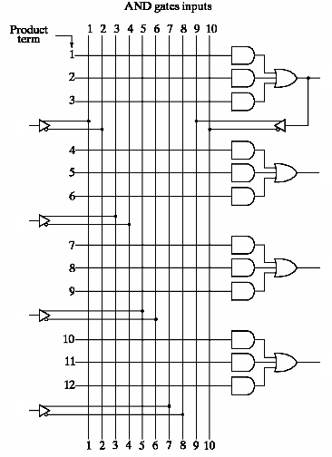
PAL implementation
w
A
x
B
y
C
z
D

Slide 54
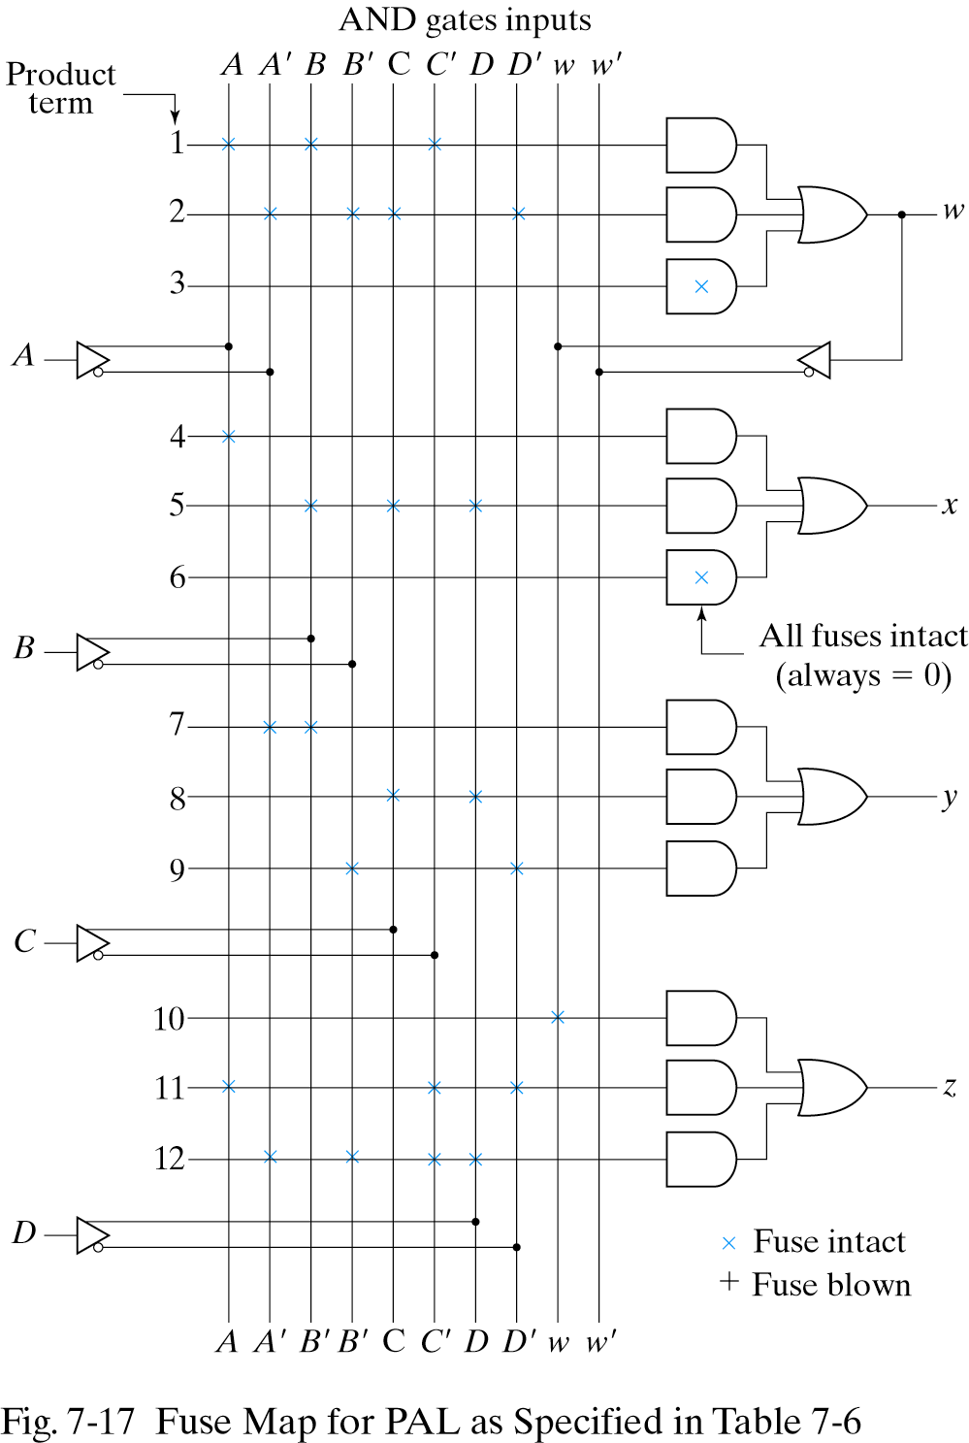
Fuse map for example

Slide 55
7-8. Sequential Programmable Devices
Sequential programmable devices include both gates and flip-flops.
There are several types of sequential programmable devices, but the internal logic of these devices is too complex to be shown here.
We will describe three major types without going into their detailed construction.

Slide 56
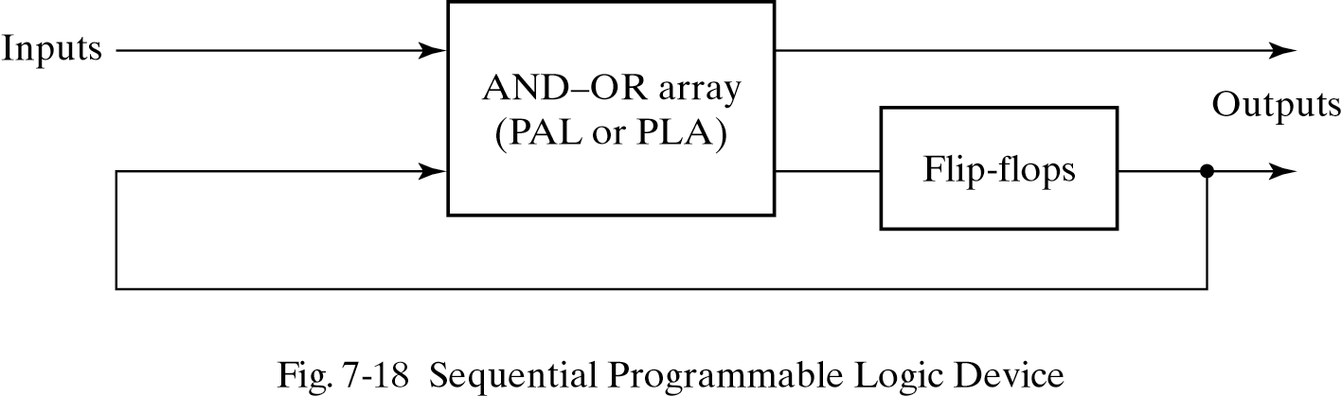
Sequential Programmable Devices
Sequential (or simple) Programmable Logic Device (SPLD)
Complex Programmable Logic Device (CPLD)
Field Programmable Gate Array (FPGA)

Slide 57
FPLS
The first programmable device developed to support sequential circuit implementation is the field-programmable logic sequencer(FPLS).
A typical FPLS is organized around a PLA with several outputs driving flip-flops.
The flip-flops are flexible in that they can be programmed to operate as either JK or D type.
The FPLS did not succeed commercially because it has too many programmable connections.

Slide 58
SPLD
Each section of an SPLD is called a macrocell.
A macrocell is a circuit that contains a sum-of-products combinational logic function and an optional flip-flop.
We will assume an AND-OR sum of products but in practice, it can be any one of the two-level implementation presented in Sec.3-7.

Slide 59
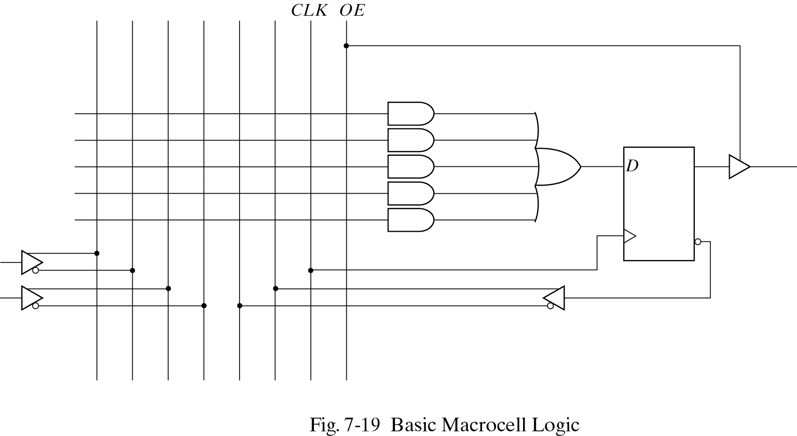
Macrocell
Fig.7-19 shows the logic of a basic macrocell.
The AND-OR array is the same as in the combinational PAL shown in Fig.7-16.

Slide 60
CPLD
A typical SPLD has from 8 to 10 macrocells within one IC package. All the flip-flops are connected to the common CLK input and all three-state buffers are controlled by the EO input.
The design of a digital system using PLD often requires the connection of several devices to produce the complete specification. For this type of application, it is more economical to use a complex programmable logic device (CPLD).
A CPLD is a collection of individual PLDs on a single integrated circuit.

Slide 61
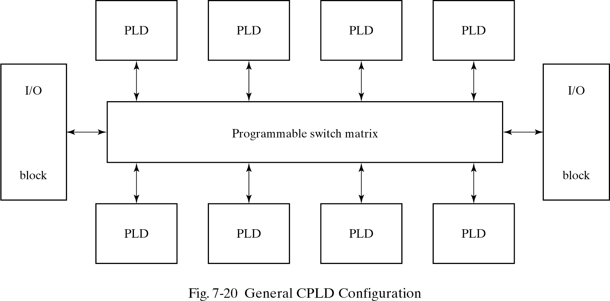
CPLD
Fig.7-20 shows a general configuration of a CPLD. It consists of multiple PLDs interconnected through a programmable switch matrix. 8 to 16 macrocell per PLD.

Slide 62
Gate Array
The basic component used in VLSI design is the gate array.
A gate array consists of a pattern of gates fabricated in an area of silicon that is repeated thousands of times until the entire chip is covered with the gates.
Arrays of one thousand to hundred thousand gates are fabricated within a single IC chip depending on the technology used.

Slide 63
FPGA
FPGA is a VLSI circuit that can be programmed in the user’s location.
A typical FPGA logic block consists of look-up tables, multiplexers, gates, and flip-flops.
Look-up table is a truth table stored in a SRAM and provides the combinational circuit functions for the logic block.

Slide 64
Differential of RAM and ROM in FPGA
The advantage of using RAM instead of ROM to store the truth table is that the table can be programmed by writing into memory.
The disadvantage is that the memory is volatile and presents the need for the look-up table content to be reloaded in the event that power is disrupted.

